Slide 1
Introduction to Big Data & Basic Data Analysis

Slide 2

Big Data EveryWhere!
Lots of data is being collected and warehoused
Web data, e-commerce
purchases at department/ grocery stores
Bank/Credit Card transactions
Social Network

Slide 3

How much data?
Google processes 20 PB a day (2008)
Wayback Machine has 3 PB + 100 TB/month (3/2009)
Facebook has 2.5 PB of user data + 15 TB/day (4/2009)
eBay has 6.5 PB of user data + 50 TB/day (5/2009)
CERN’s Large Hydron Collider (LHC) generates 15 PB a year
640K ought to be enough for anybody.

Slide 4
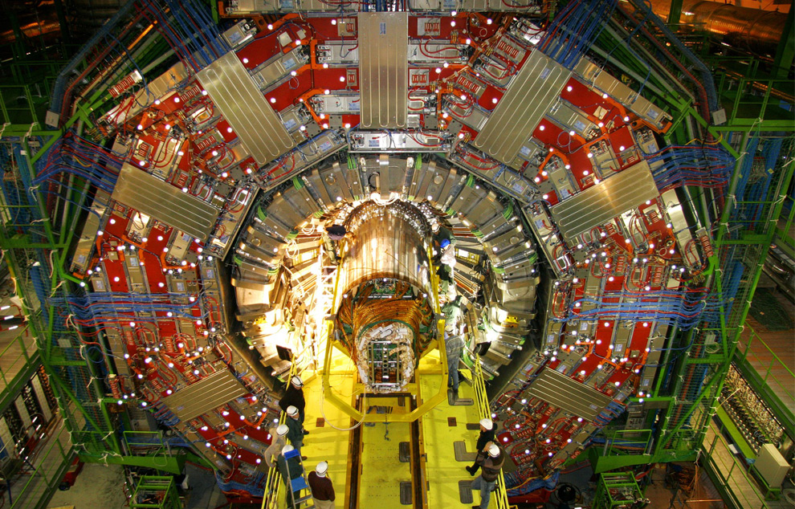
Maximilien Brice, © CERN

Slide 5

The Earthscope
1.
The Earthscope is the world's largest science project. Designed to track North America's geological evolution, this observatory records data over 3.8 million square miles, amassing 67 terabytes of data. It analyzes seismic slips in the San Andreas fault, sure, but also the plume of magma underneath Yellowstone and much, much more. (http://www.msnbc.msn.com/id/44363598/ns/technology_and_science-future_of_technology/#.TmetOdQ--uI)

Slide 6
Type of Data
Relational Data (Tables/Transaction/Legacy Data)
Text Data (Web)
Semi-structured Data (XML)
Graph Data
Social Network, Semantic Web (RDF), …
Streaming Data
You can only scan the data once

Slide 7
What to do with these data?
Aggregation and Statistics
Data warehouse and OLAP
Indexing, Searching, and Querying
Keyword based search
Pattern matching (XML/RDF)
Knowledge discovery
Data Mining
Statistical Modeling

Slide 8
Statistics 101

Slide 9
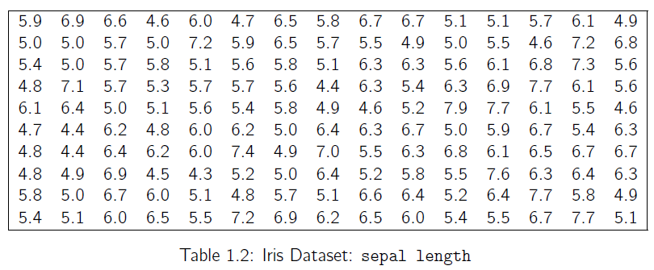
Random Sample and Statistics
Population: is used to refer to the set or universe of all entities under study.
However, looking at the entire population may not be feasible, or may be too expensive.
Instead, we draw a random sample from the population, and compute appropriate statistics from the sample, that give estimates of the corresponding population parameters of interest.

Slide 10
Statistic
Let Si denote the random variable corresponding to data point xi , then a statistic ˆθ is a function ˆθ : (S1, S2, · · · , Sn) → R.
If we use the value of a statistic to estimate a population parameter, this value is called a point estimate of the parameter, and the statistic is called as an estimator of the parameter.

Slide 11
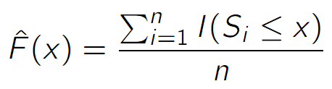
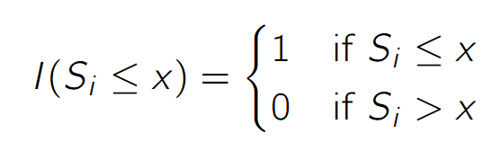
Empirical Cumulative Distribution Function
Where
Inverse Cumulative Distribution Function

Slide 12
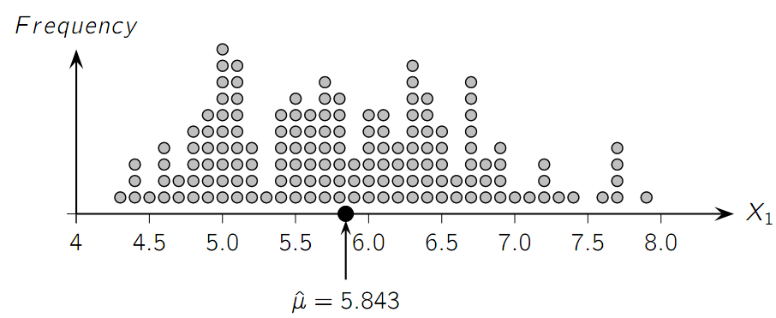
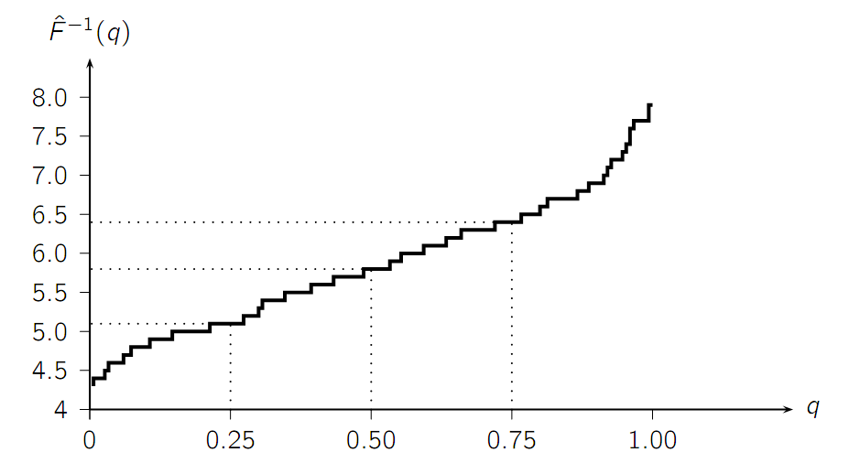
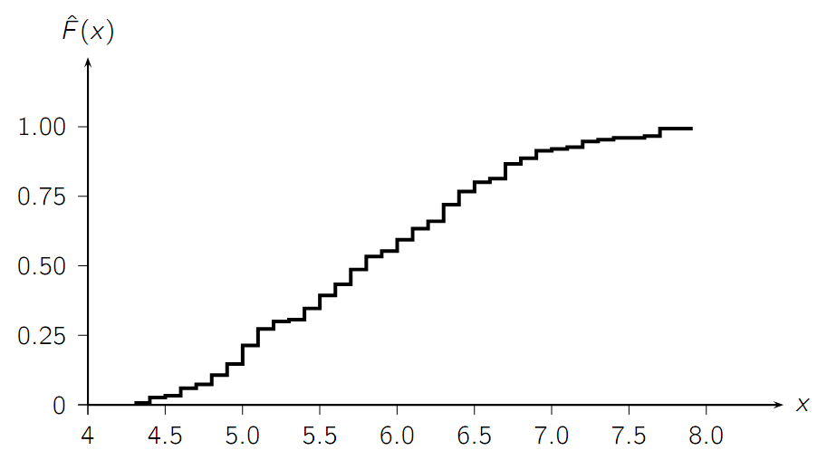
Example

Slide 13
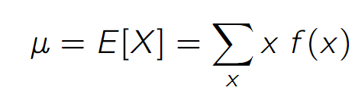
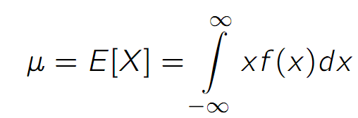
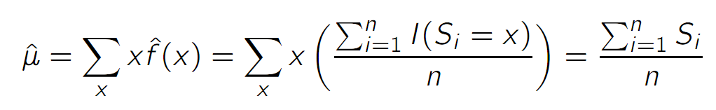
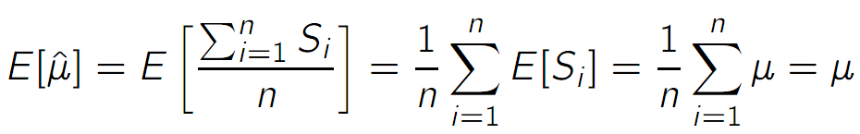
Measures of Central Tendency (Mean)
Population Mean:
Sample Mean (Unbiased, not robust):

Slide 14
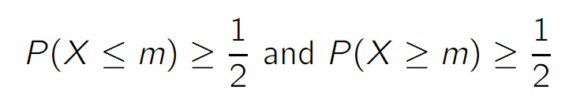
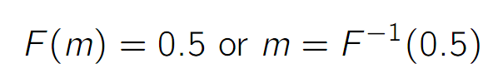
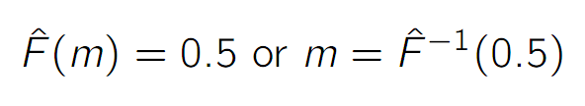
Measures of Central Tendency (Median)
Population Median:
or
Sample Median:

Slide 15
Example

Slide 16

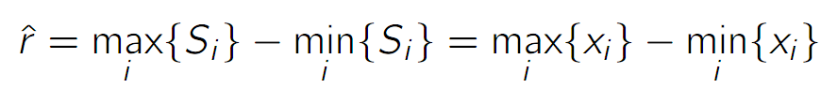
Measures of Dispersion (Range)
Range:
Sample Range:
Not robust, sensitive to extreme values

Slide 17




Measures of Dispersion (Inter-Quartile Range)
Inter-Quartile Range (IQR):
Sample IQR:
More robust

Slide 18
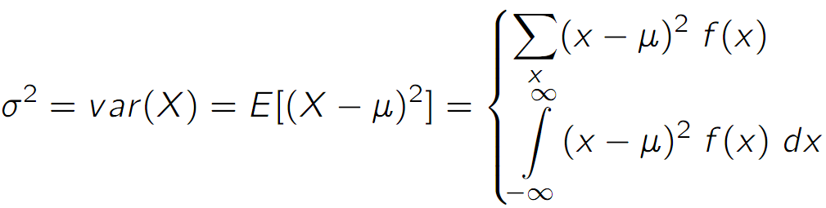
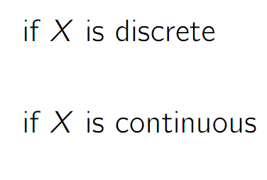
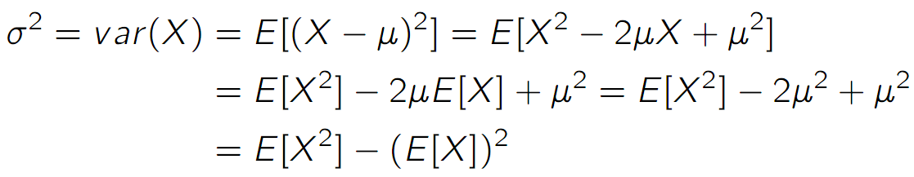
Measures of Dispersion (Variance and Standard Deviation)
Variance:
Standard Deviation:

Slide 19
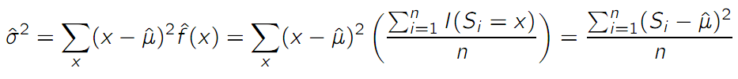
Measures of Dispersion (Variance and Standard Deviation)
Variance:
Standard Deviation:
Sample Variance & Standard Deviation:

Slide 20
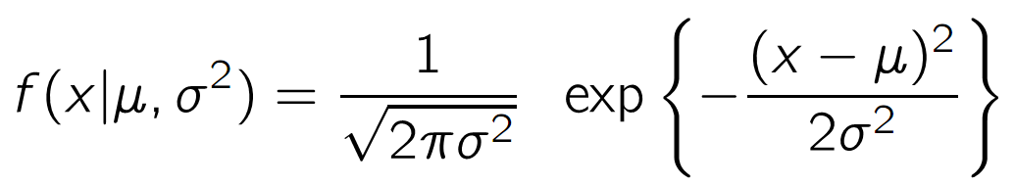
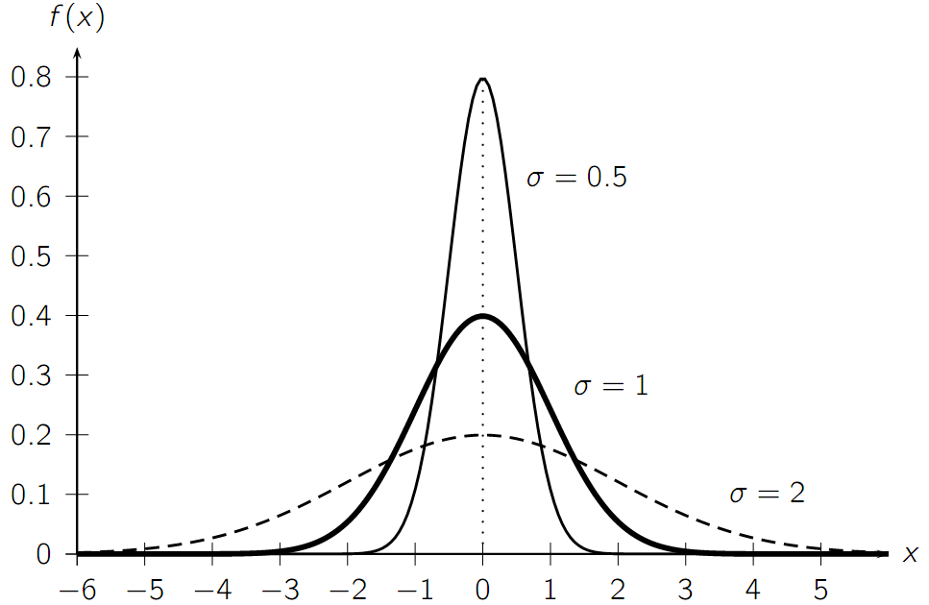
Univariate Normal Distribution

Slide 21
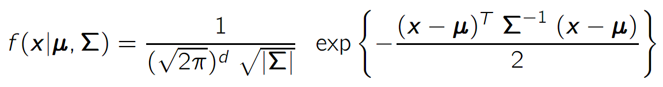
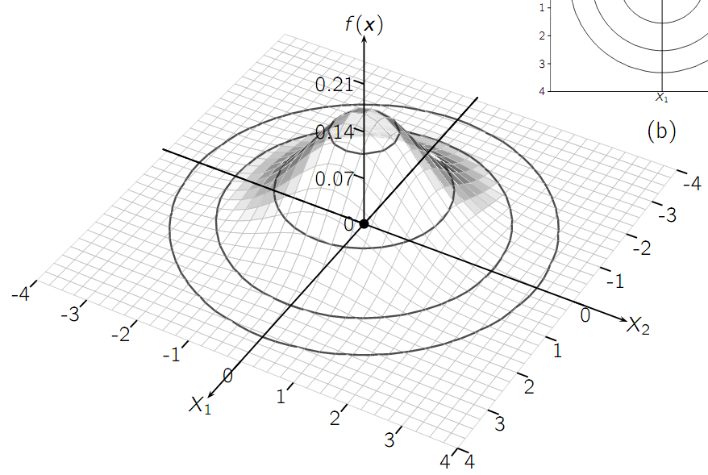
Multivariate Normal Distribution

Slide 22
OLAP and Data Mining

Slide 23
Warehouse Architecture
Client
Client
Query & Analysis
Metadata
Warehouse
Integration
Source
Source
Source

Slide 24
Star Schemas
A star schema is a common organization for data at a warehouse. It consists of:
Fact table : a very large accumulation of facts such as sales.
Often “insert-only.”
Dimension tables : smaller, generally static information about the entities involved in the facts.

Slide 25
Terms
Fact table
Dimension tables
Measures

Slide 26
Star

Slide 27
Cube
Fact table view:
Multi-dimensional cube:
dimensions = 2

Slide 28
3-D Cube
Fact table view:
Multi-dimensional cube:
day 2
day 1
dimensions = 3

Slide 29
ROLAP vs. MOLAP
ROLAP: Relational On-Line Analytical Processing
MOLAP: Multi-Dimensional On-Line Analytical Processing

Slide 30
Aggregates
Add up amounts for day 1
In SQL: SELECT sum(amt) FROM SALE
WHERE date = 1
81

Slide 31
Aggregates
Add up amounts by day
In SQL: SELECT date, sum(amt) FROM SALE
GROUP BY date

Slide 32
Another Example
Add up amounts by day, product
In SQL: SELECT date, sum(amt) FROM SALE
GROUP BY date, prodId
rollup
drill-down

Slide 33
Aggregates
Operators: sum, count, max, min, median, ave
“Having” clause
Using dimension hierarchy
average by region (within store)
maximum by month (within date)

Slide 34
What is Data Mining?
Discovery of useful, possibly unexpected, patterns in data
Non-trivial extraction of implicit, previously unknown and potentially useful information from data
Exploration & analysis, by automatic or semi-automatic means, of large quantities of data in order to discover meaningful patterns

Slide 35
Data Mining Tasks
Classification [Predictive]
Clustering [Descriptive]
Association Rule Discovery [Descriptive]
Sequential Pattern Discovery [Descriptive]
Regression [Predictive]
Deviation Detection [Predictive]
Collaborative Filter [Predictive]

Slide 36
Classification: Definition
Given a collection of records (training set )
Each record contains a set of attributes, one of the attributes is the class.
Find a model for class attribute as a function of the values of other attributes.
Goal: previously unseen records should be assigned a class as accurately as possible.
A test set is used to determine the accuracy of the model. Usually, the given data set is divided into training and test sets, with training set used to build the model and test set used to validate it.

Slide 37
Decision Trees
Example:
Conducted survey to see what customers were interested in new model car
Want to select customers for advertising campaign
training
set

Slide 38
Clustering
income
education
age

Slide 39
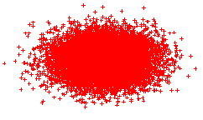
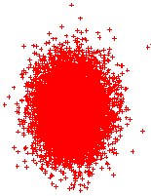

K-Means Clustering

Slide 40
Association Rule Mining
transaction
id
customer
id
products
bought
sales
records:
market-basket
data
Trend: Products p5, p8 often bough together
Trend: Customer 12 likes product p9

Slide 41
Association Rule Discovery
Marketing and Sales Promotion:
Let the rule discovered be
{Bagels, … } --> {Potato Chips}
Potato Chips as consequent => Can be used to determine what should be done to boost its sales.
Bagels in the antecedent => can be used to see which products would be affected if the store discontinues selling bagels.
Bagels in antecedent and Potato chips in consequent => Can be used to see what products should be sold with Bagels to promote sale of Potato chips!
Supermarket shelf management.
Inventory Managemnt
Notes:
If a customer buys diaper and milk, then he is very likely to buy beer.
So, don’t be surprised if you find six-packs stacked next to diapers!

Slide 42
Collaborative Filtering
Goal: predict what movies/books/… a person may be interested in, on the basis of
Past preferences of the person
Other people with similar past preferences
The preferences of such people for a new movie/book/…
One approach based on repeated clustering
Cluster people on the basis of preferences for movies
Then cluster movies on the basis of being liked by the same clusters of people
Again cluster people based on their preferences for (the newly created clusters of) movies
Repeat above till equilibrium
Above problem is an instance of collaborative filtering, where users collaborate in the task of filtering information to find information of interest

Slide 43
Other Types of Mining
Text mining: application of data mining to textual documents
cluster Web pages to find related pages
cluster pages a user has visited to organize their visit history
classify Web pages automatically into a Web directory
Graph Mining:
Deal with graph data

Slide 44
Data Streams
What are Data Streams?
Continuous streams
Huge, Fast, and Changing
Why Data Streams?
The arriving speed of streams and the huge amount of data are beyond our capability to store them.
“Real-time” processing
Window Models
Landscape window (Entire Data Stream)
Sliding Window
Damped Window
Mining Data Stream

Slide 45
A Simple Problem
Finding frequent items
Given a sequence (x₁,…x_{N}) where x_{i} ∈[1,m], and a real number θ between zero and one.
Looking for x_{i} whose frequency > θ
Naïve Algorithm (m counters)
The number of frequent items ≤ 1/θ
Problem: N>>m>>1/θ
P×(Nθ) ≤ N

Slide 46
KRP algorithm ─ Karp, et. al (TODS’ 03)
m=12
N=30
Θ=0.35
⌈1/θ⌉ = 3
N/ (⌈1/θ⌉) ≤ Nθ

Slide 47
Streaming Sample Problem
Scan the dataset once
Sample K records
Each one has equally probability to be sampled
Total N record: K/N

